Slide 1
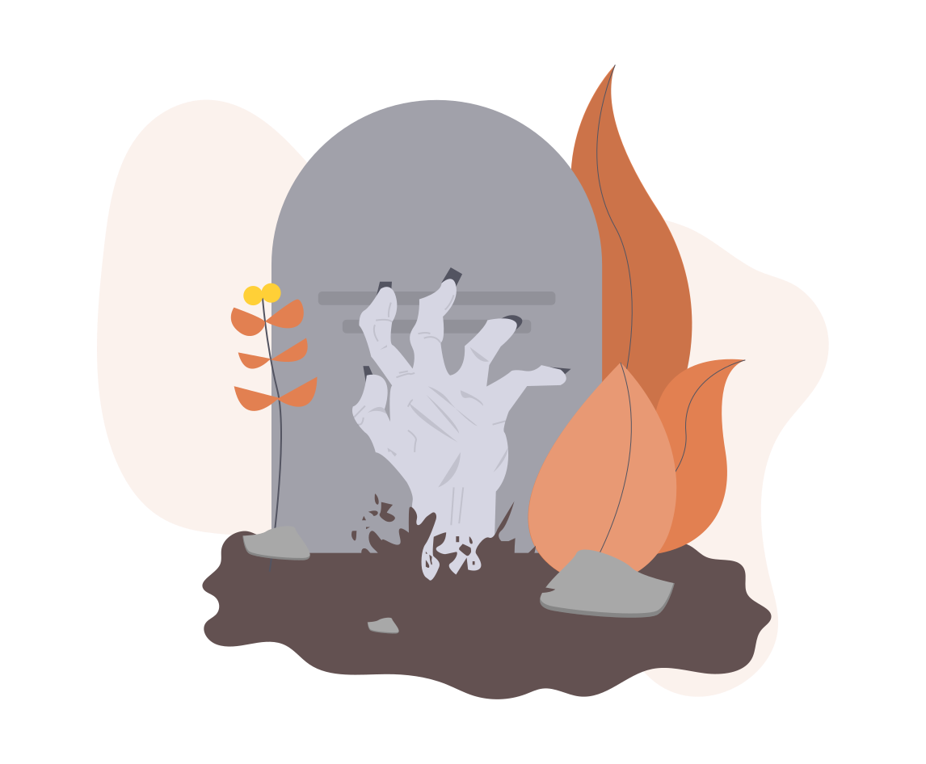
Google
Graveyard
Lokeswaran J

Slide 2
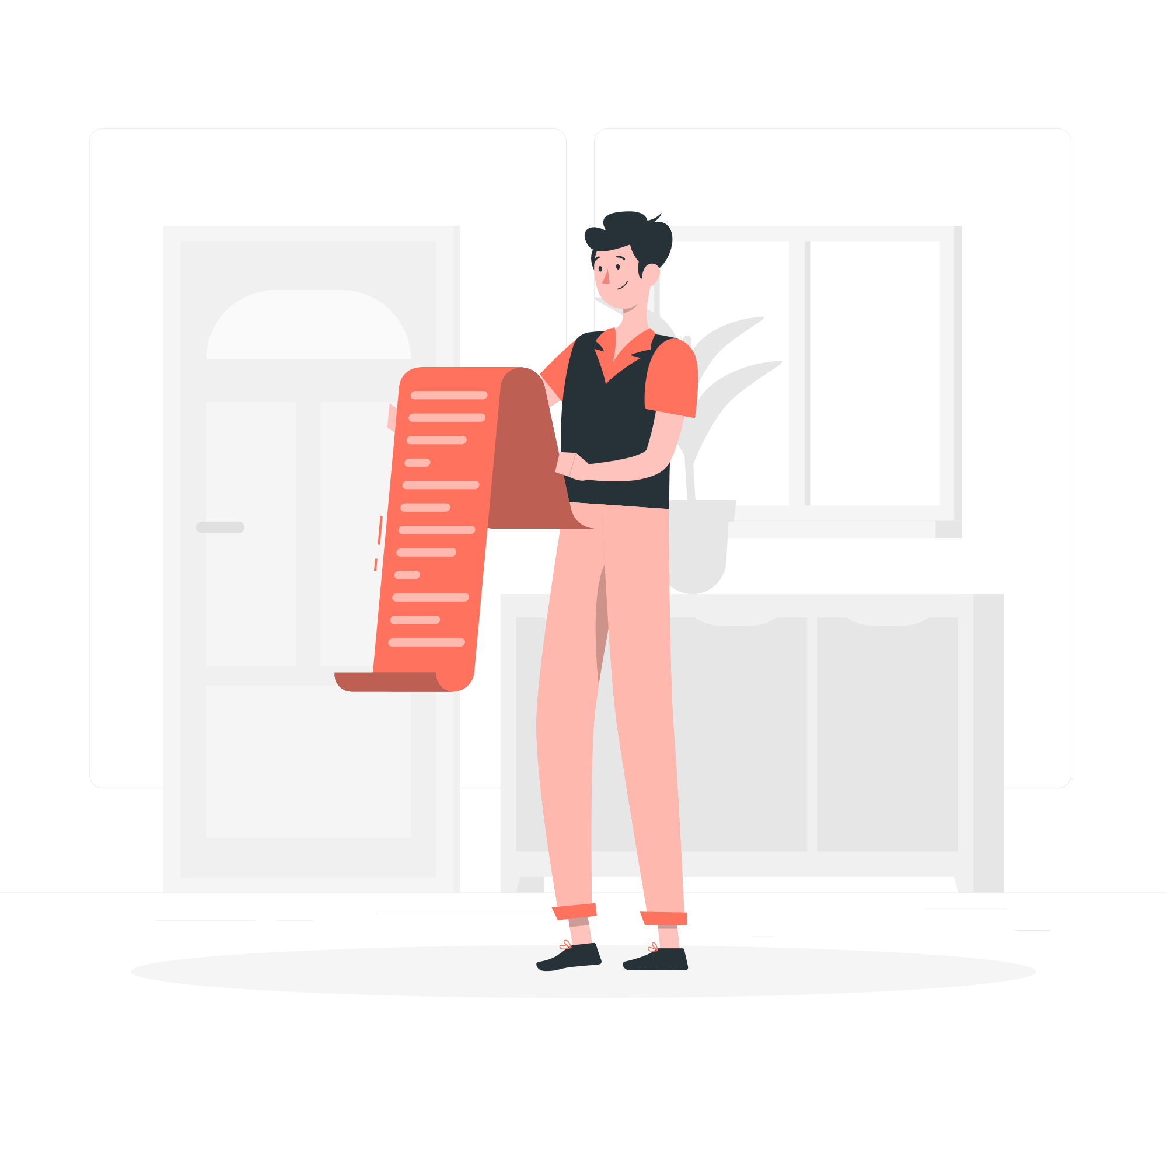
Agenda
Google Graveyard
No. of Products
Apps
Services
Hardware
Products that will be stopped
Why killed
Impact

Slide 3
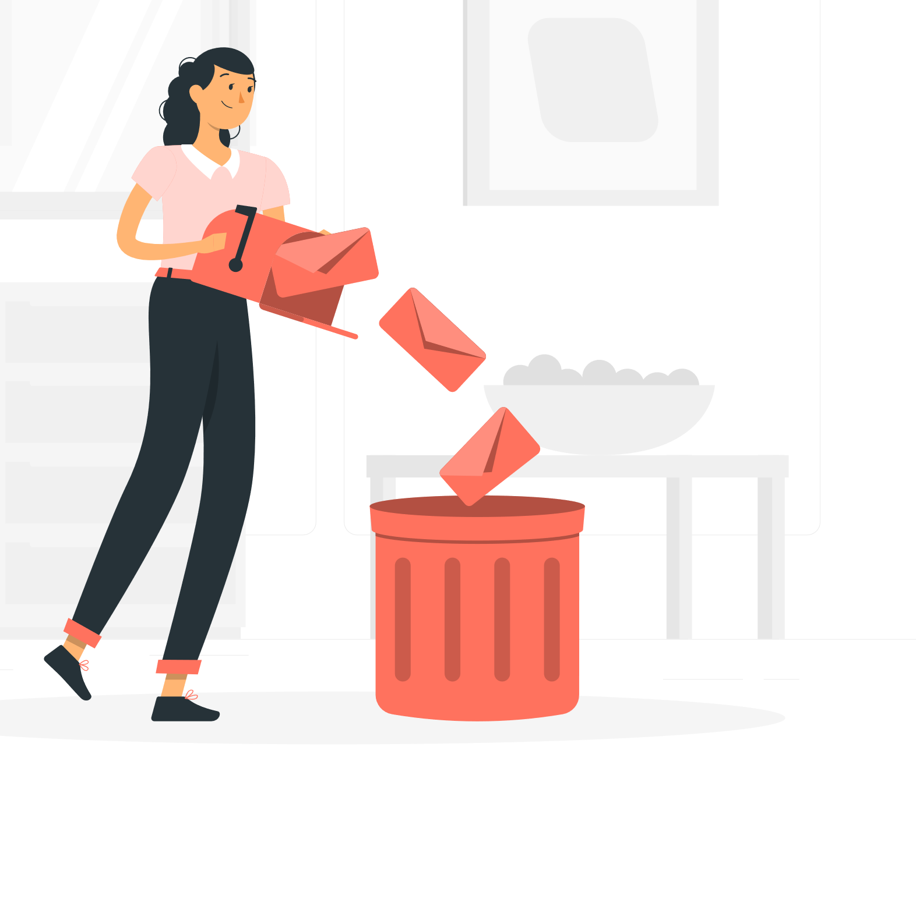
Google Graveyard
Google graveyard is a free and open source list of discontinued Google services, products, devices, and apps.
It aims to be a source of factual information about the history surrounding Google's dead projects.

Slide 4
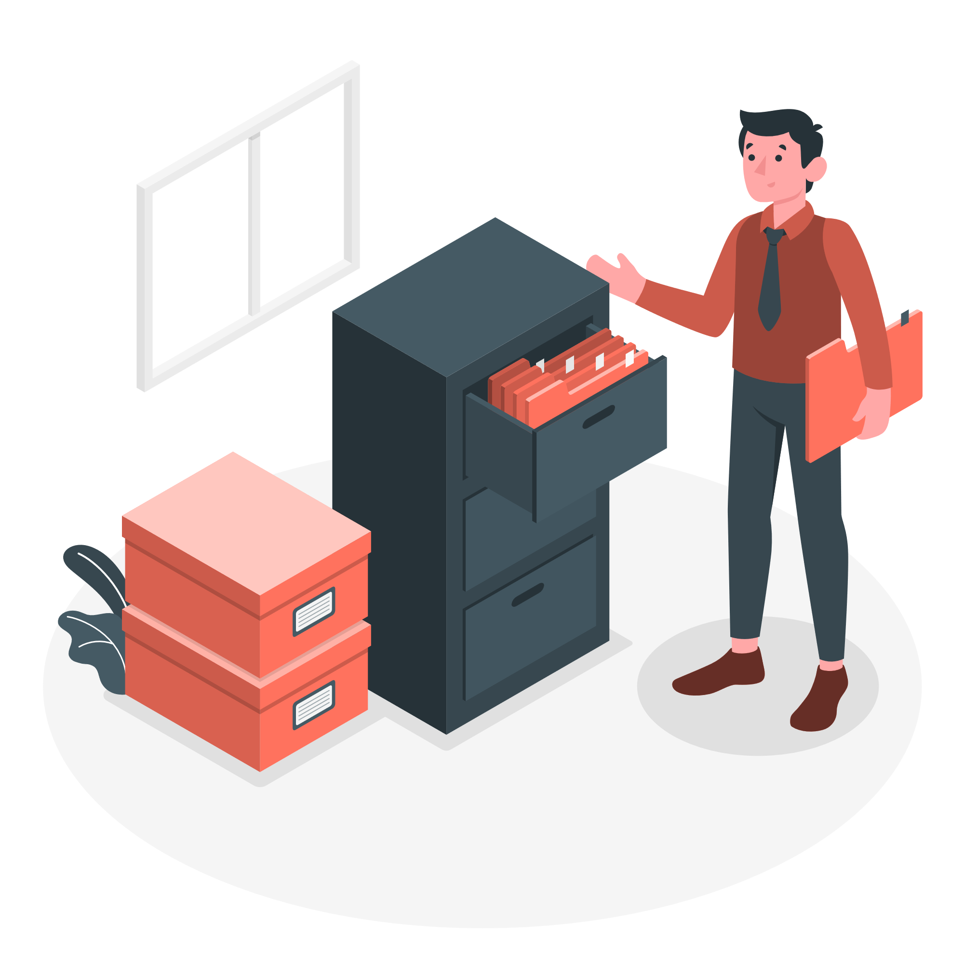
No. of products
The total number of products that was killed by google is 227,
they are classified into three categories as follows:
Apps - 36
Services - 171
Hardware - 20

Slide 5
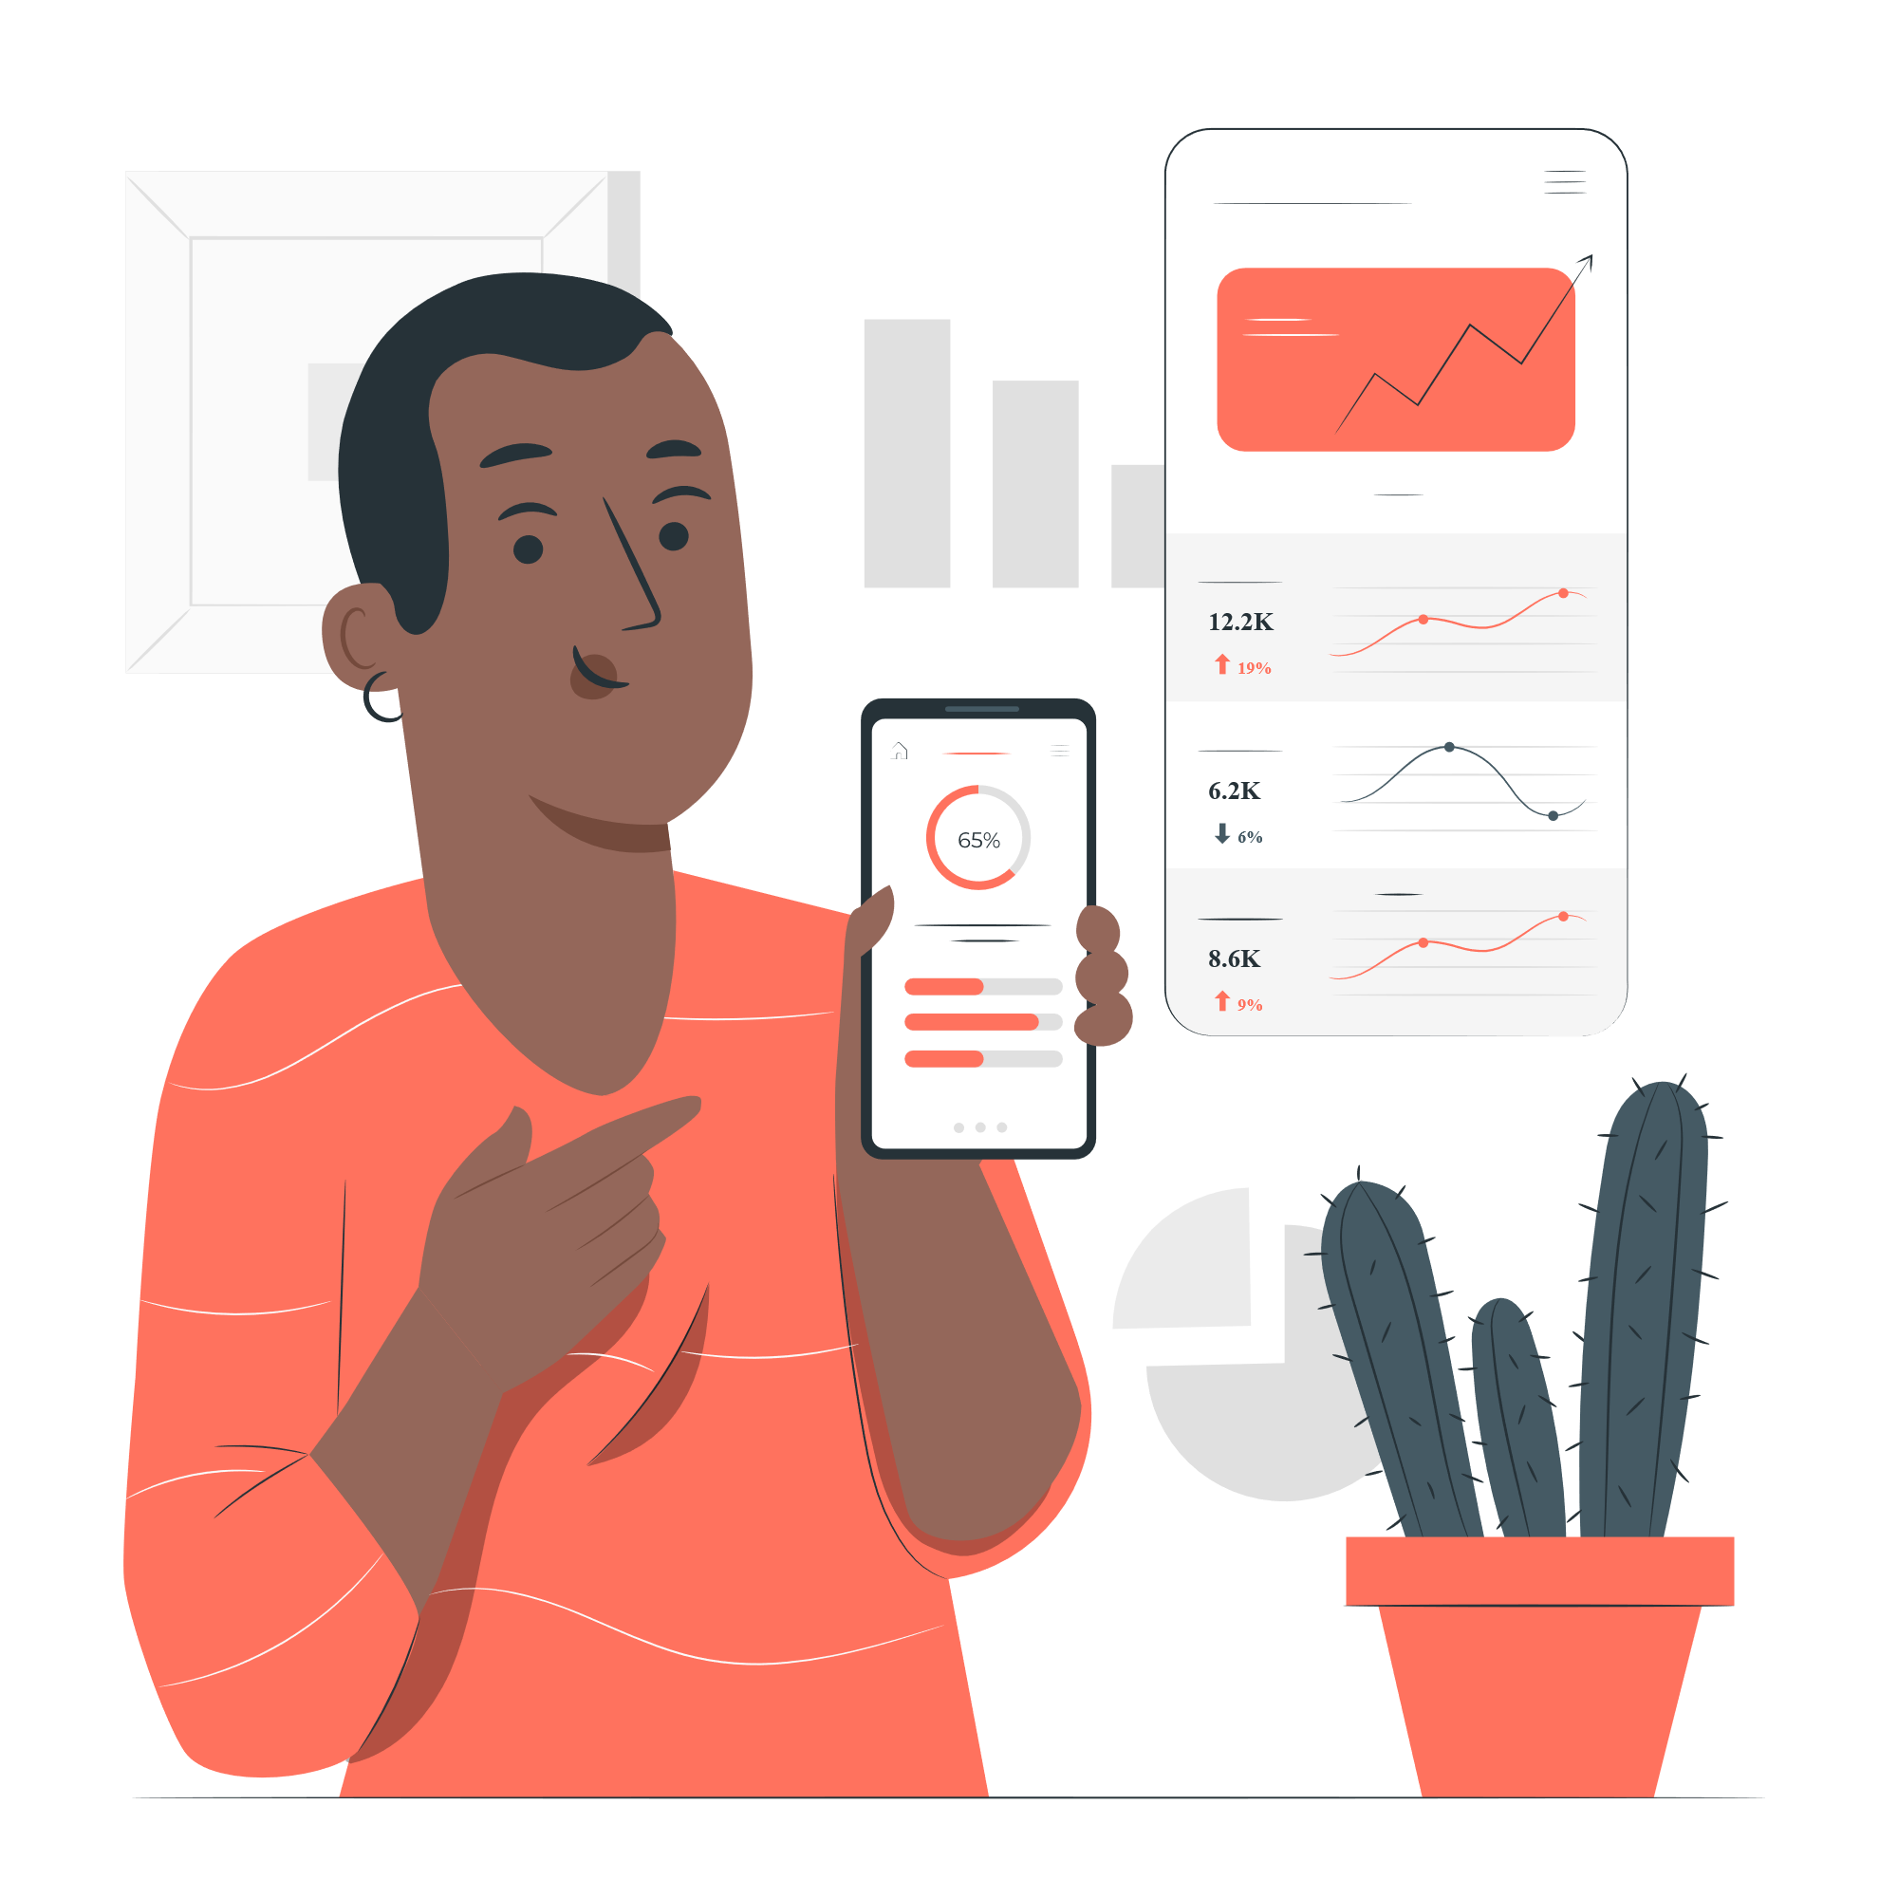
Apps
As we seen in last slide, 36 apps are stopped by google.
Some of them are Google News & Weather, Google gesture search, Google Allo, etc..

Slide 6
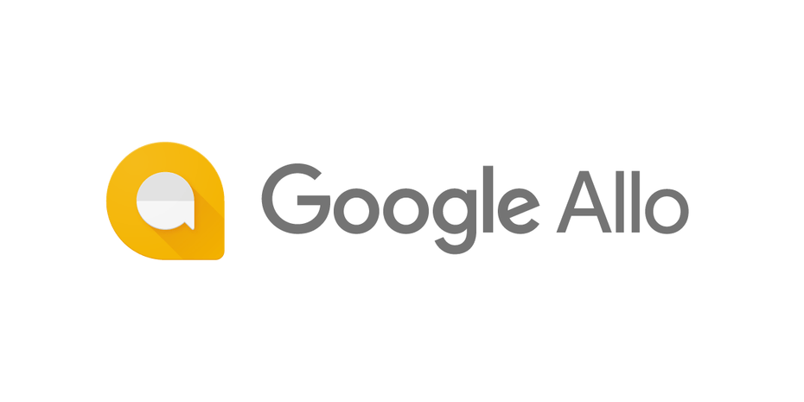
Google Allo
Google Allo was an instant messaging mobile app for Android, iOS, and Web with special features like a virtual assistant and encrypted mode.
It was rebranded as Google Chat.
It was about 2 years old, from 2016 to 2019.

Slide 7
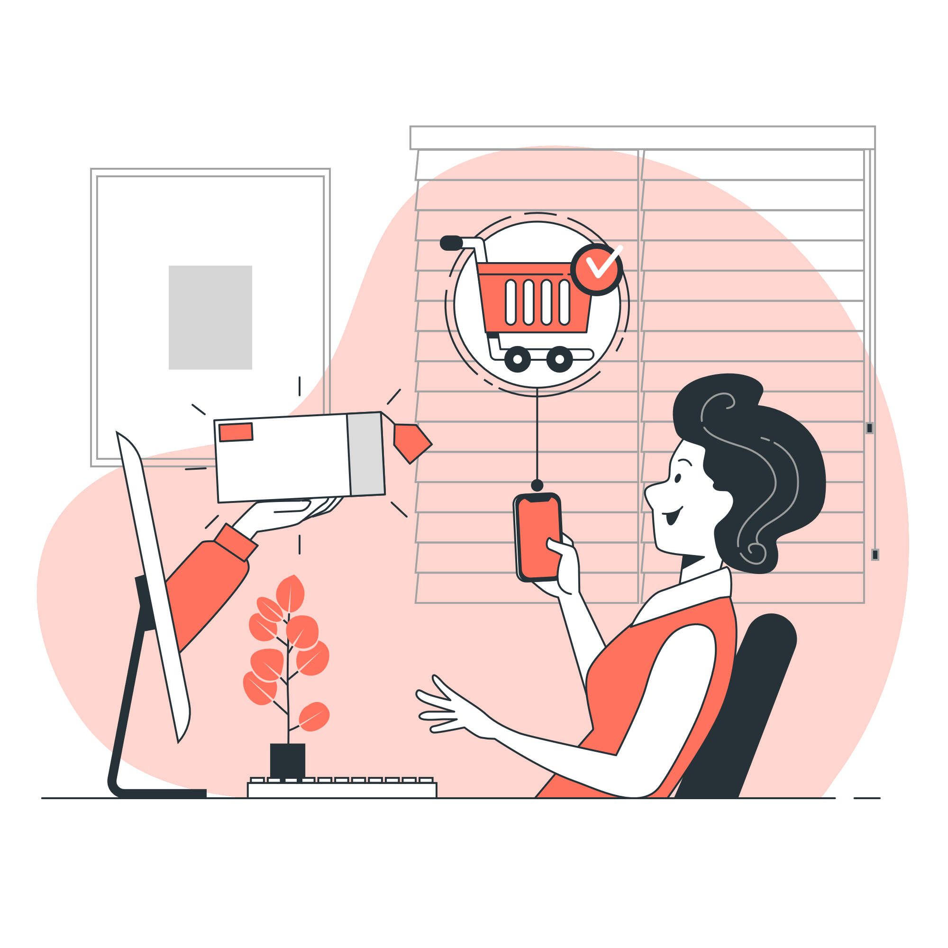
Services
In the all categories, highest is services which is nearly 171.
Some of them are Inbox by Gmail, Google Play Music, Google Plus, etc..

Slide 8
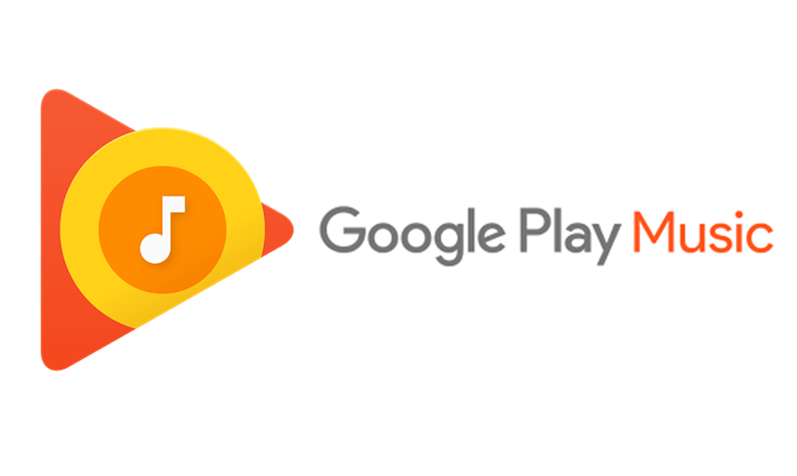
Google Play Music
Google Play Music was a music and podcast streaming service, and online music locker..
It will be about 9 years old.
It was used from 2011 to 2020.

Slide 9
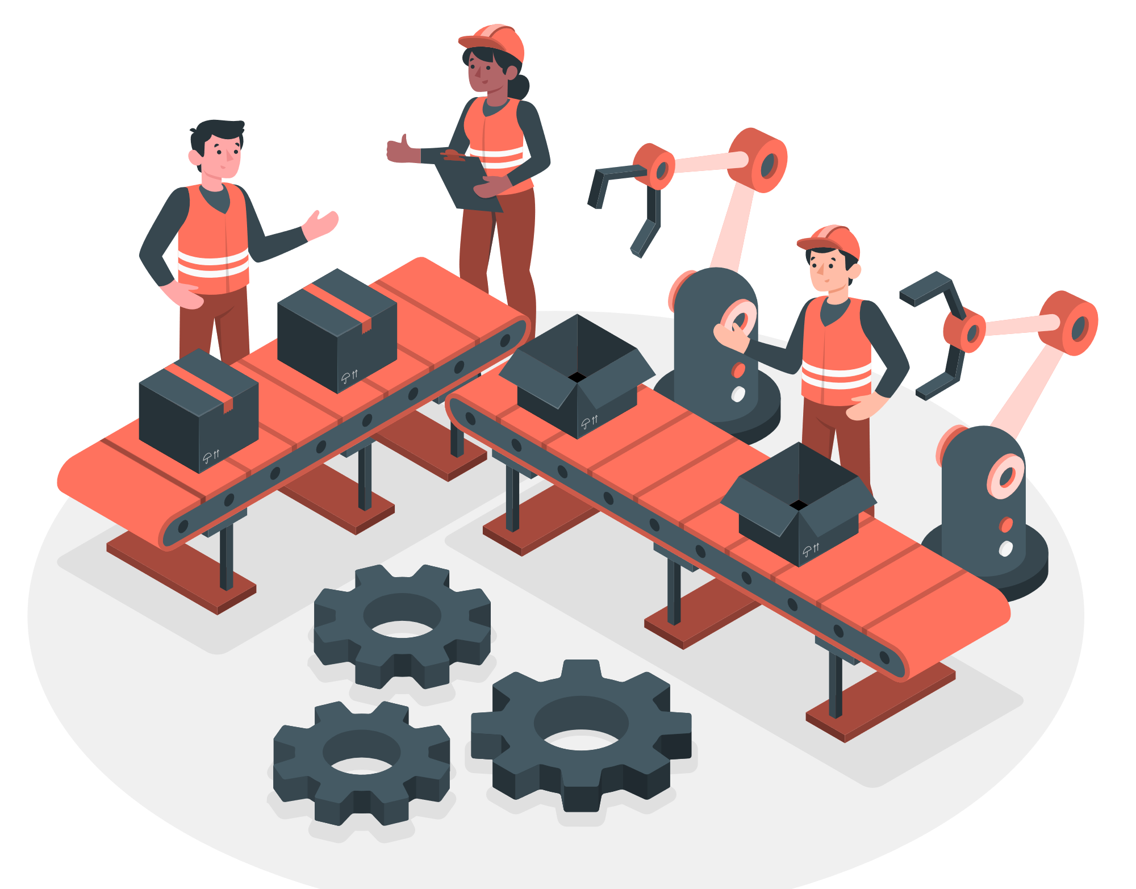
Hardware
In the all categories, lowest is hardware which is nearly 20.
Some of them are Google Nexus, Google Cardboard, Google TV etc..

Slide 10
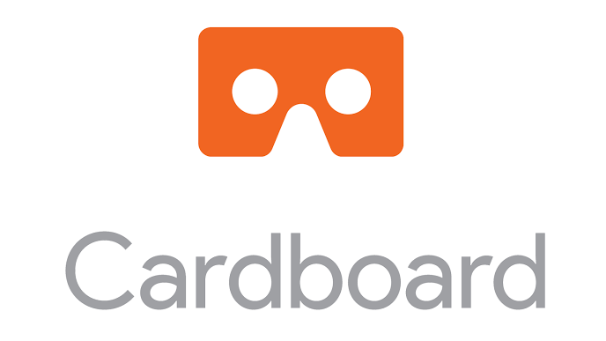
Google Cardboard
Google Cardboard was a low-cost, virtual reality (VR) platform named after its folded cardboard viewer into which a smartphone was inserted.
It was over 6 years old, from 2014 to 2021.
It was stopped just 16 days ago.

Slide 11
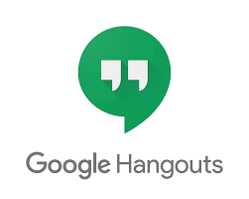


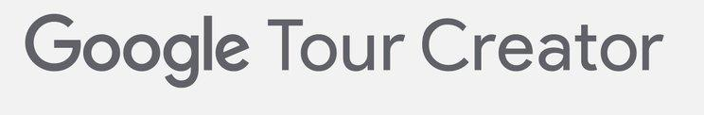


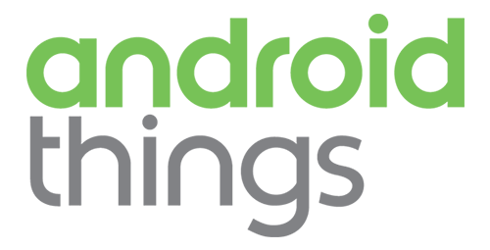
Products that will be stopped
June 2021
June 2021
June 2021
June 2021
December 2021
January 2022

Slide 12
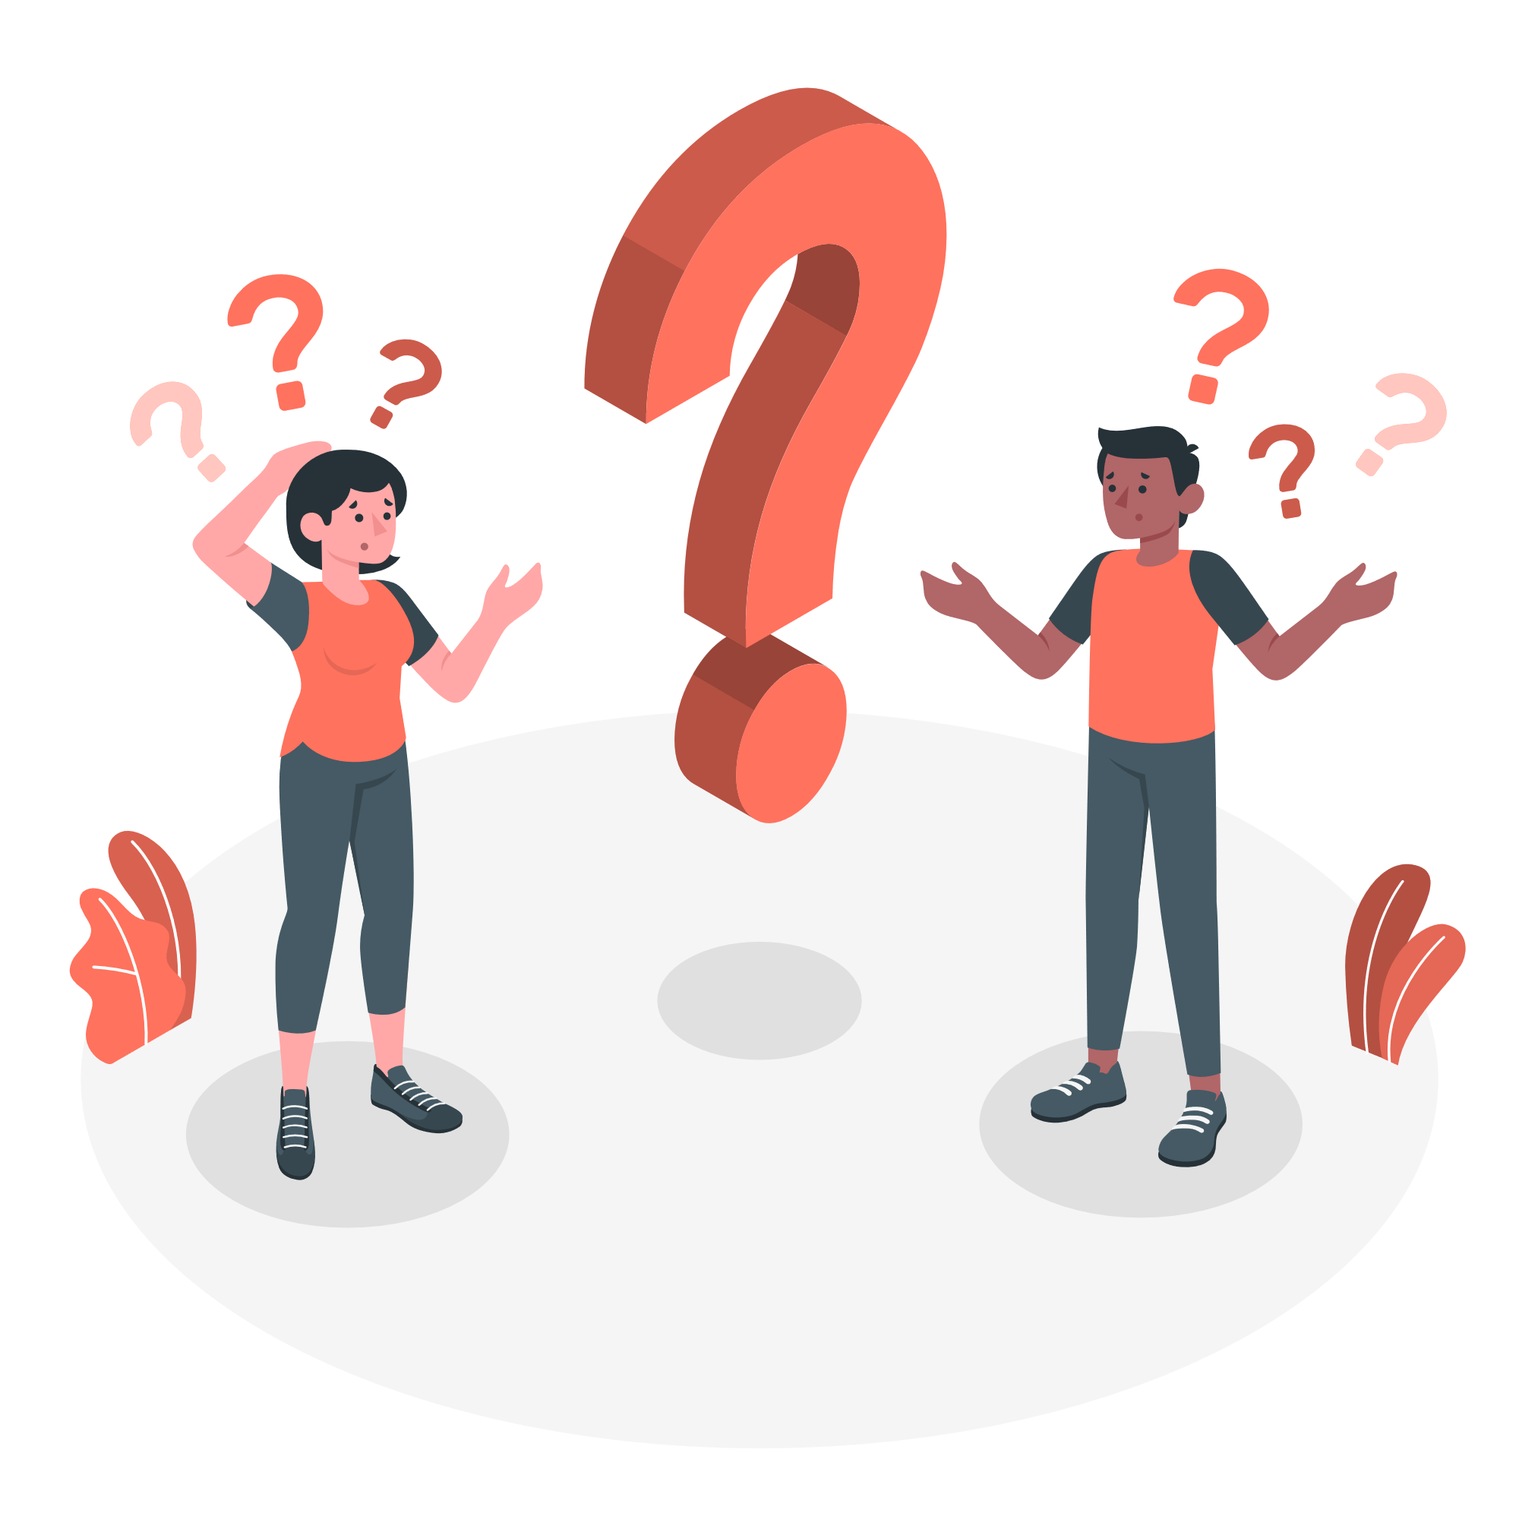
Why killed ?
Lot of teams work independently in Google, when the focus of the team changes, the product they develop changes too.
In 2011, Google has Google Play Music, but now we also have Youtube Music , both are very similar. So, they replace the latest one.
Services are also been shut down when they are outdated, instead of being updated they are cancelled.

Slide 13
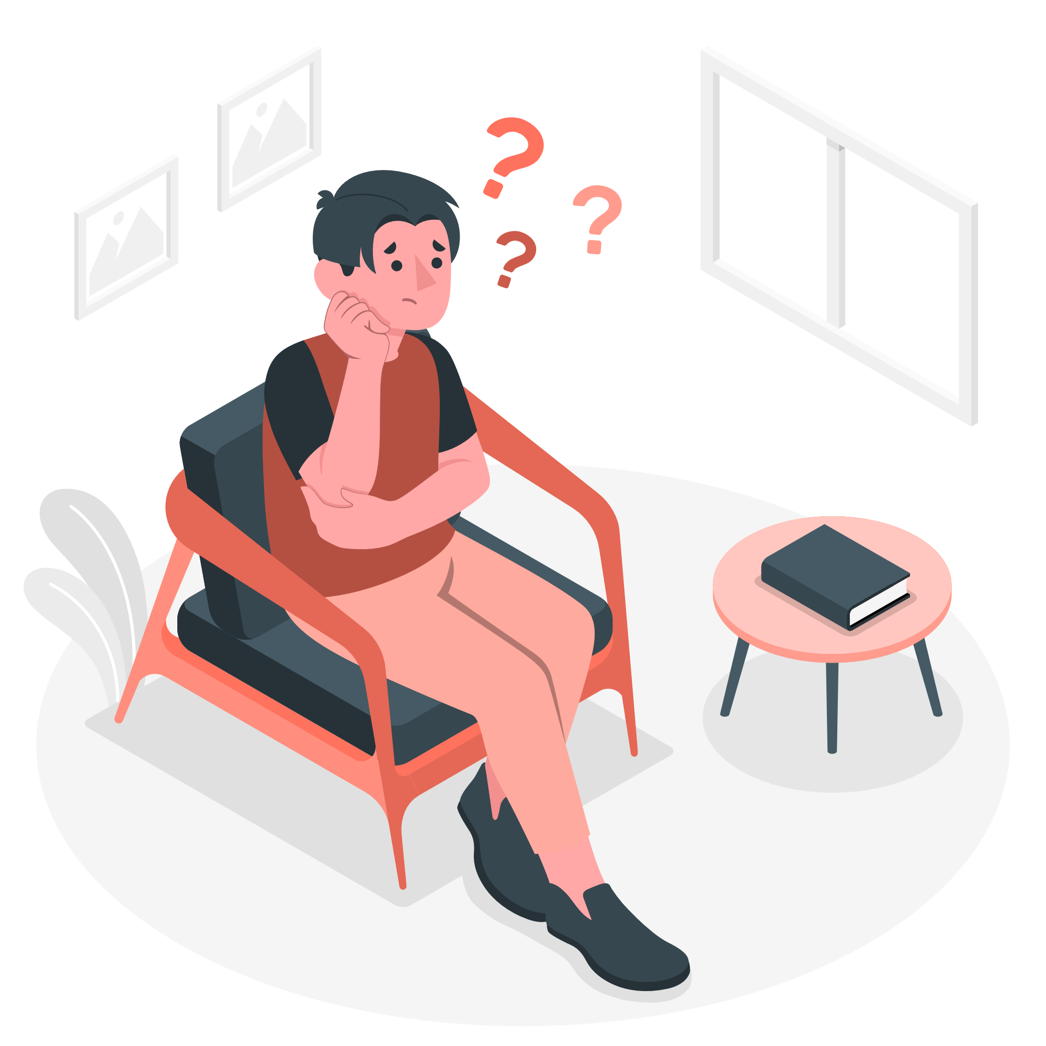
Impact
Google has killed totally 227 things but it does not make any big impact, because it did not stop gmail or youtube.
What happens is that the new version or a rebranded version of that old app or service they kill shows up later.

Slide 14
Thank You !

